Slide 1
Chronic Idiopathic Urticaria:
A Primer on Identification and Treatment
Moderator
Allen P. Kaplan, MD
Clinical Professor of Medicine
Medical University of South Carolina
Charleston, South Carolina

Slide 2
Urticaria
Definitions
Acute: < 6 weeks’ duration, typically due to allergy to a food or medication; in children, can be related to a transient viral illness
Physical: no symptoms unless physical stimulus occurs; occurs intermittently
Examples: dermatographism, cold urticaria, cholinergic urticaria (exercise), solar urticaria, pressure-induced urticaria
Chronic (idiopathic/spontaneous*): symptoms most days of the week for 6 weeks, typically no identifiable precipitant
*Hereafter referred to as CIU
Bernstein JA, et al. J Allergy Clin Immunol. 2014;133:1270-1277.^{[1]}
Notes:
2

Slide 3
Epidemiology of CIU
Female preponderance of 70%
Increased symptoms during menses
Disability caused by pruritus, sleeplessness, scratching, angioedema
Limits use of hands, feet, speech; facial hives/angioedema are disfiguring
Loss of work and schooling
Anxiety and depression
As disabling as Grade 3 CHF
O’Donnell BF. Immunol Allergy Clin N Am. 2014;34:89-104.^{[2]}
Notes:
3

Slide 4
Characteristics of Physical Urticarias*
Hives last < 2 hours
Stimulus (eg, ice cube test, exercise, scratching) has no late-phase response
Treated readily with antihistamines, but may require high doses
Do not respond to corticosteroids
*Except delayed-pressure urticaria
Soter N. Seminar Dermatology. 1987;6:302-312.^{[3]}
Notes:
4

Slide 5
Cold Urticaria
Image courtesy of…
Notes:
5
Photo credit: pending promised faculty permission

Slide 6
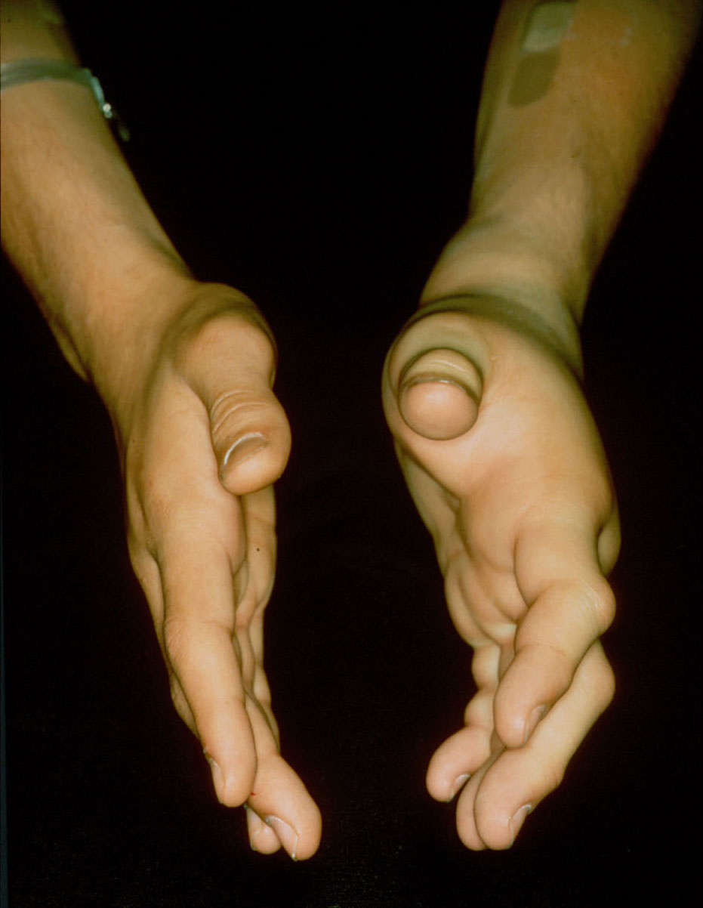
Cold-induced Angioedema in a Patient With Cold Urticaria
Image courtesy of…
Notes:
6
Photo credit: pending promised faculty permission

Slide 7
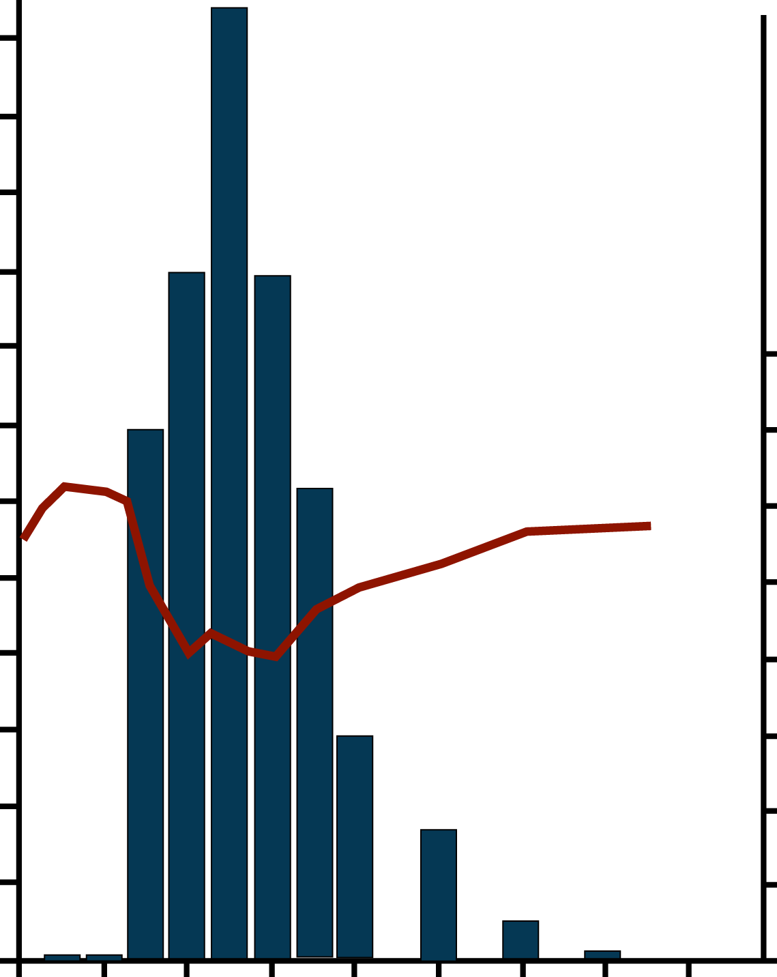
Histamine Release in Cold Urticaria
240
Histamine release
BP
220
200
180
160
160
140
140
Histamine, ng/mL
120
120
100
100
Blood Pressure, mm Hg
80
80
60
60
40
40
20
20
0
0
-4 0 4 8 12 16 20 24 28
Time, min
Adkinson NF Jr, et al. Middleton’s Allergy: Principles and Practice, 7th ed. 2009:1063-1081.^{[4]}
Notes:
7
CME Dept: The fix requested in the sticky note is in progress.

Slide 8
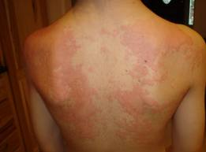
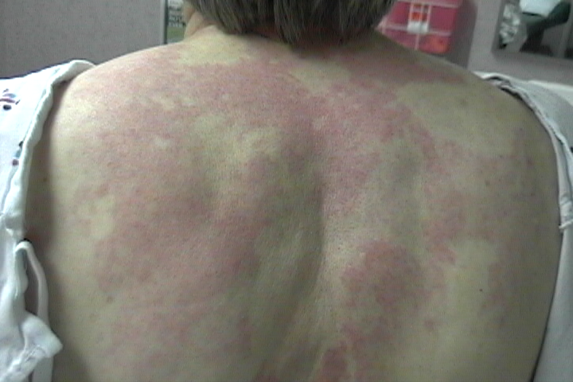
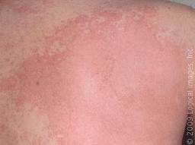
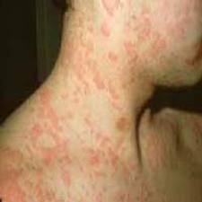
Physical Manifestations of CIU
Image courtesy of Allen P. Kaplan, MD.
Notes:
8

Slide 9
Recognized Associations With CIU
Angioedema: occurs in 40%-80% of patients in different series, mainly affecting the eyelids, lips, or tongue; although alarming, it is never fatalª
Physical urticaria (usually symptomatic dermatographism, or delayed-pressure urticaria) occurs in about 50% of patients^{b}
Thyroid abnormalities (particularly antithyroid antibodies) occur in about 25% of patients and may be clinically evident hypothyroid
Hashimoto thyroiditis is frequently found^{c}
a. Kaplan AP. J Allergy Clin Immunol. 2004;114:465-474.^{[5]}
b. Greaves MW. N Eng J Med. 1995;332:1767-1772.^{[6]}
c. Leznoff A, Sussman GL. J Allergy Clin Immunol. 1989;84:66-71.^{[7]}
Notes:
9

Slide 10
Laboratory Evaluation of CIU
Initial testing includes CBC with differential, ESR, and CRP
Further testing only if suggested by history
Routine skin testing not necessary or recommended
Zuberbier T, et al. Allergy. 2014;69:868-887.^{[8]}
Notes:
10

Slide 11
Optional Laboratory Tests
Antithyroid antibodies and thyroid function tests
Antibody to high-affinity IgE receptor
Tests to rule out vasculitis (incidence < 1.0%) only if symptoms are suggestive (eg, fever, purpura, arthralgia)
C3, C4, C1q binding assay for immune complexes and skin biopsy are reasonable
Zuberbier T, et al. Allergy. 2014;69:868-887.^{[8]}
Notes:
11

Slide 12
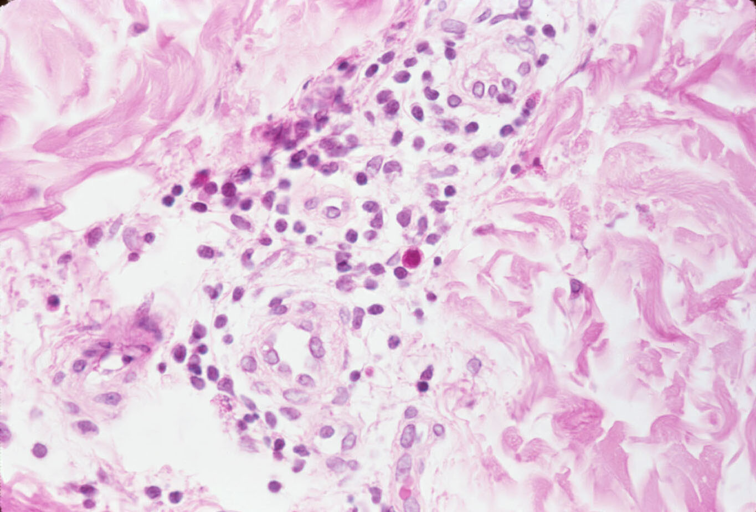
Skin Biopsy of CIU
Infiltration around
small, intact blood vessels
Endothelial cells
Image courtesy of…
Notes:
12
Pending faculty requesting permission
Are the arrows correct, are they pointing to blood vessels?
Which cells are the endothelial cells?

Slide 13
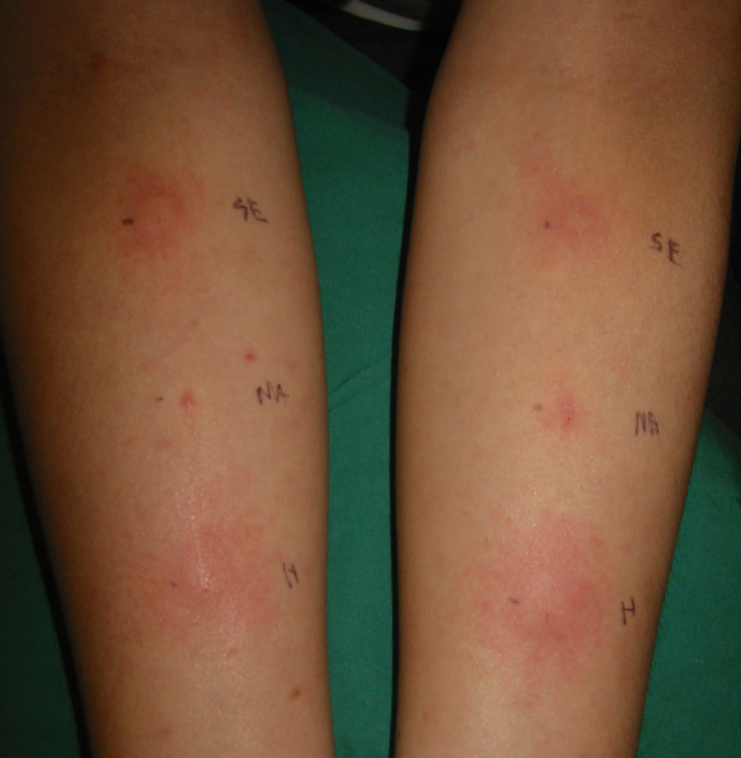
ASST
Significance of a negative ASST: rules out autoimmune urticaria
Significance of a positive ASST: indicates the presence of autoreactivity in the serum, but in vitro confirmation is required before this can be attributed to functional autoantibodies
Test reading depends on induction of histamine release from cutaneous mast cells
Serum
Saline
Histamine
Positive ASST
Image courtesy of…
Notes:
13
Photo credit: pending promised faculty permission

Slide 14
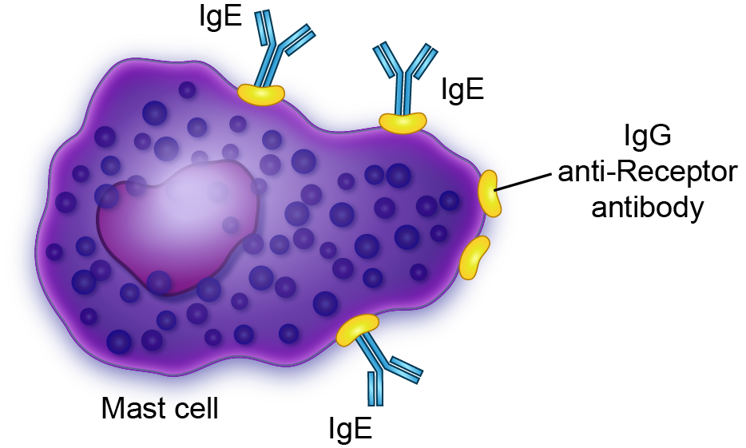
Autoantibody-dependent Activation of Mast Cells
IgG anti-receptor antibody → Secretion → “Late phase” reaction → Infiltrative hive
Kaplan AP. Middleton's Allergy: Principles and Practice. 2009;1063-1081.^{[4]}
Notes:
14

Slide 15
Identification of Anti-IgE Receptor Antibody
Histamine Release, %
Reprinted from Kaplan AP, Joseph K. J Allergy Clin Immunol. 2007;120:729-730, with permission from Elsevier.^{[10]}
Notes:
15
Requesting permission from publisher to use.

Slide 16
Autoimmunity and CIU
Cutaneous mast cells and basophils can be activated by IgG antibody to the α subunit of the IgE receptorª
Basophil histamine release by purified IgG anti-IgE receptor is augmented by complementª
Augmentation of basophil histamine release is inhibited by removal of C5 or blockade of the C5a receptor; thus, C5a augments the histamine releaseª
Anti-receptor antibody (IgG) subclasses are predominantly IgG₁ and IgG₃, which are associated with complement fixation by the classical pathway^{b}
a. Kikuchi Y, Kaplan AP. J Allergy Clin Immunol. 2002;109:114-118.^{[11]}
b. Soundararjan S, et al. J Allergy Clin Immunol. 2005;115:815-821.^{[12]}
Notes:
16

Slide 17
Histamine Release Upon Stimulation With Anti-IgE
Patient Group | Histamine Release, %
Control | 51.04
Atopic | 50.91
Urticaria | 10.41
Luquin E, et al. Clin Exp Allergy. 2005;35:456-460.^{[13]}
Notes:
17

Slide 18
Summary
IgG anti-α cross-links the IgE receptor to activate cutaneous mast cells and basophils
Complement activation and C5a, in particular, augments the reaction
IgG₂ anti-α causes false-positive immunoblot test and is nonfunctional; IgG₁ and IgG₃ anti-α are responsible for cell activation in CIU
Basophils in patients with CIU are hyporesponsive to anti-IgE, responsiveness returns to normal when they remit or are treated with omalizumab
The extrinsic coagulation cascade is activated
Notes:
18

Slide 19
Criteria for Efficacy in Treating Chronic Urticaria
Must be better than placebo effect, which is 30% in all medical studies
Current guidelines recommend drugs that are effective in ≤ 30% or may be effective in subpopulations of patients (eg, “neutrophilic” infiltration, which is no more than 5%-15% of patients)
Current guidelines do not recommend biopsy unless urticarial vasculitis, which occurs in about 1% of patients, is suspected

Slide 20
Effectiveness of Levocetirizine and Desloratadine* Given at Up to 4 Times† Conventional Doses for Difficult-to-treat Urticaria
Major outcome: no increase in somnolence when daily medication dose was increased
Surprising finding: a paradoxical decrease in somnolence over time in patients treated with levocetirizine
*Third-generation nonsedative antihistamines
†This is an off-label recommendation.
Staevska M, et al. J Allergy Clin Immunol. 2010;125:676-682.^{[14]}

Slide 21
Cyclosporine
A calcineurin inhibitor with good efficacy, even in severe cases
Dosage: 200-300 mg/d
Confirmed by double-blind, placebo-controlled study in patients with autoimmune CU
Unconfirmed efficacy in CIU and delayed-pressure urticaria
Alternative to corticosteroids
When contraindicated
Significant adverse effects
Monitor blood pressure, BUN, serum creatinine
Grattan CE, et al. Br J Dermatol. 2000;143:365-372.^{[15]}
Toubi E, et al. Allergy. 1997;52:312-316.^{[16]}

Slide 22
Omalizumab Phase 3 Clinical Studies in Patients With CIU
 | ASTERIA I | ASTERIA IIª | GLACIAL^{b}
Length of background therapy, wk | H₁-antihistamines at approved doses ≥ 8 Weeks | H₁-antihistamines at approved doses ≥ 8 | H₁-antihistamines at up to 4x approved dose + H₂-blocker and/or LTRA > 6 weeks
Length of therapy, wk | 24 | 12 | 24
Length of study, wk | 40 | 28 | 40
Dose of omalizumab, mg | 75, 150, 300 | 75, 150, 300 | 300
LTRA = leukotriene receptor antagonist
a. Maurer M, et al. N Engl J Med. 2013;368:924-935.^{[18]}
b. Kaplan A, et al. J Allergy Clin Immunol. 2013;132:101-109.^{[19]}
Notes:
22

Slide 23
ASTERIA II Omalizumab 150 and 300 mg for 12 Weeks Significantly Improved UAS7 and Hives Score vs Placebo
UAS7 (secondary end point)
Omalizumab
Placebo
75 mg
150 mg
300 mg
0
Mean Change From Baseline in UAS7 Score at Week 12
–5
P > .05
–10
–15
P = .02
P < .001
Data are for mITT population;
mITT = modified intention-to-treat population; UAS7 = weekly urticaria activity
–25
Maurer M, et al. N Engl J Med. 2013;368:924-35.^{[18]}

Slide 24
ASTERIA II Omalizumab Increased the Proportion of Patients Who Were Well Controlled or Free of Itch and Hive
UAS7 ≤ 6
(secondary end point)
UAS7 = 0
(post-hoc analysis)
90
P < .05
50
75
40
60
P < .05
Proportion of Patients With UAS7 = 0 at Week 12, %
Proportion of Patients With UAS7 ≤ 6 at Week 12, %
30
45
P > .05
20
30
15
10
0
75 mg
150 mg
0
75 mg
150 mg
300 mg
Placebo
300 mg
Placebo
Omalizumab
Omalizumab
Data are for mITT population;
Maurer M, et al. N Engl J Med. 2013;368:924-935.^{[18]}

Slide 25
GLACIAL Significant Improvements in UAS7 at Week 12 With Sustained Benefit at Week 24
 | Mean change from baseline in UAS7 score
 | Week 12 | Week 24*
Placebo | – 8.5 | – 6.9
Omalizumab 300 mg | – 19.0 | – 13.2
P Value | < .001 | < .001
*At week 24, least squares mean treatment difference was 10.0
Data are for mITT population.
Kaplan A, et al. J Allergy Clin Immunol. 2013;132:101-109.^{[19]}

Slide 26
GLACIAL Omalizumab Increased the Proportion of Patients Well Controlled or Free of Itch and Hives
 | Proportion of Patients With UAS7 ≤ 6 at Week 12, %* | Proportion of Patients With UAS7 = 0 at Week 12, %*
Placebo | 12.0 | 4.8
Omalizumab 300 mg | 52.4 | 33.7
P Value | < .001 | < .001
*Secondary end point.
Data are for mITT population.
Kaplan A, et al. J Allergy Clin Immunol. 2013;132:101-109.^{[19]}

Slide 27
Treatment Recommendations for CIU
First Line
Use second-generation antihistamines.
If symptoms persist after 2 weeks
Second Line
Increase dosage of second-generation antihistamines up to 4-fold.
If symptoms persist after 1-4 further weeks
Third Line
Add omalizumab, cyclosporine, or montelukast to second-line drugs.
A short course (max 10 days) of corticosteroids may also be used at all times if exacerbations occur.
Zuberbier T, et al. Allergy. 2014;69:868-887.^{[8]}
Notes:
27

Slide 28
Stepwise Treatment of CIU
Step 1
Monotherapy with second-generation antihistamine
Avoidance of triggers (eg, NSAIDs) and relevant physical factors if physical urticaria/angioedema syndrome is present
Step 2
One or more of the following
Dose advancement of second-generation antihistamine used in step 1
Add another second-generation antihistamine
Add H₂-antagonist
Add LTRA
Add first-generation antihistamine to be taken at bedtime
Bernstein JA, et al. J Allergy Clin Immunol. 2014;133:1270-1277.^{[1]}
Notes:
28

Slide 29
Stepwise Treatment of CIU (cont)
Step 3
Dose advancement of potent antihistamine (eg, hydroxyzine or doxepin) as tolerated
Step 4
Add an alternate agent
Anti-inflammatory agent (eg, dapsone, hydroxychloroquine, sulfasalazine)
Immunosuppressant agent (eg, cyclosporine, mycophenolate)
Biologic agent (omalizumab)
Bernstein JA, et al. J Allergy Clin Immunol. 2014;133:1270-1277.^{[1]}
Notes:
29

Slide 30
Therapeutic Response
Agent | Response Rate, % | Notes
Antihistamines | 40-65 | Requires high dose: up to 4 times the dose* recommended for allergic rhinitis
Corticosteroids | 95 | May require high doses; probably 60%-70% response for prednisone ≤ 15 mg
Cyclosporine | 70
Omalizumab | 65-75
*This is an off-label recommendation.
Kaplan AP. Ann Allergy Asthma Immunol. 2014;112:419-425.^{[20]}

Slide 31
Approaches to Consider When Antihistamines Fail
Recommended | For Consideration | Not Recommended
Omalizumab Cyclosporine | Dapsone Hydroxychloroquine Sulfasalazine Colchicine Methotrexate IV gamma globulin Plasmapheresis | Corticosteroids* H₂ receptor antagonists Leukotriene antagonists
* Failure of antihistamines, omalizumab, and cyclosporine may leave no option other than those listed in the middle column or use of a low-dose chronic corticosteroid with provisos.
Kaplan AP. Ann Allergy Asthma Immunol. 2014;112:419-25.^{[20]}

Slide 32
Treatment of CIU
Step 1: Nonsedative, second- or third-generation antihistamines* 4 times daily; decrease the dose as tolerated once symptoms are controlled
If response is inadequate, step 2
Omalizumab 300 mg monthly
If no response after 2 injections
Step 3: cyclosporine 200-300 mg/d
Step 4: drugs to consider if steps 1-3 fail
Dapsone, methotrexate, sulfasalazine, hydroxychloroquine, IV gamma globulin, plasmapheresis
*Dose of cetirizine, loratadine, desloratadine, or levocetirizine that correspond to hydroxyzine or diphenhydramine 50 mg 4 times daily is 6 tablets/d.
Kaplan AP. Ann Allergy Asthma Immunol. 2014;112:419-425.^{[20]}

Slide 33
Thank you for participating in this activity.
You may now revisit those questions presented at the beginning of the activity to see what you’ve learned by clicking on the Earn CME/CE Credit link. The CME posttest will follow. Please also take a moment to complete the program evaluation at the end.

